Slide 1
Ayur Hindustan Natural Resources Pvt ltd

Slide 2
Mission statement
Spread Knowledge , thereby uplifting global community needs in HEALTHCARE, FOOD, HOUSING
Business profit by welfare of society
To be a global organization dedicated to wealth creation by bridging opportunity with resources while promoting the interest of the stakeholders and society.

Slide 3
Vision Statement
Our primary purpose as an organization is to deliver high quality service to the Society.
Empowering challenged people by enabling them to, have access to
    Best health
    Best Education
    B est shelter
Educate , Empower, Help & Grow
Investing in viable economic ventures for a profit while promoting the interests of stakeholders and the society.

Slide 4
Key verticals
Ayur Hindustan
Healthcare
Agriculture
Low cost housing

Slide 5
Board of directors
Dr Abdul Raj Vakil Siddquie- Chairman
Dr Nigar Abdul Siddquie- Director
Dr Abdul Mateen Siddquie- Director

Slide 6
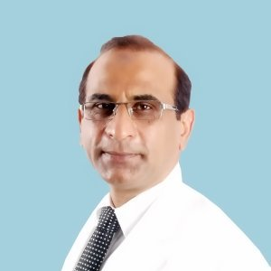
Profile of Board of Directors
Medical Practitioner Since 1985 at Nagpur. ▪ Professional Assistance in Establishing 14 primary, Middle and High School in Nagpur, Wardha, Chandrapur, Bhandara (Maharashtra), Raipur (Chhattisgarh) Professional Assistance in Establishing Ayurvedic & Unani, Allopathic Medical Colleges in Nagpur and Pauni. Professional Assistance for Establishing Universities of Bio-Technology, Life Science, Engineering, Business Management, Education and Information Technology at Raipur, (Chhattisgarh).
Professional Assistance for Establishing College of Engineering & Technology, at Nagpur for pallotine Education Society, Nagpur.
Ten years field-working experience with Gramin Vikas Shikshan Sanstha, Pauni in promotion of Rural Education. Ten years working experience in programs for Quality Up Gradation of Rural primary Education in Maharashtra and Chhattisgarh for Minorities, Backward Classes and Tribals.
Ten years working experience with first De-Addiction Centre for Alcoholics and Drug-Addicts, Matruseva Sangh Nagpur. (World Bank Project)
Dr. Raj Vakil Siddiqui

Slide 7
Advisors
Dr V Ponraj His one of the Advisor cum shisya of Dr A P J Abdulkalam
Mr Armoogum Parsuramen Excellency Hon’able Former HRD Minister Mauritius
Dr Raghunath Anant Mashelkar former Director General of the CSIR
Dr Prasad Durjati Department of Chemical & Biomolecular Engineering University of Delaware

Slide 8
Board of directors
Dr Abdul Raj Vakil Siddquie- Chairman
Dr Nigar Abdul Siddquie- Director
Dr Abdul Mateen Siddquie- Director

Slide 9
International technology Transfer and enterprise commercialization – The critical need for capacity enhancement

Slide 10
International technology Transfer and enterprise commercialization – The critical need for capacity enhancement
Policy Planners and global development agencies
  PART I & Part II
Universities
Public Research Institutions
Corporations
Scaled up AHRPL intervention with strategic linkage to national & international organizations engaged in fostering STI
  Pooling of
  IP
  & know how
CLEARING HOUSE
CONSULTING & LEGAL SERVICES
CONVENING
TRAINING CAPACITY BUILDING
Regional knowledge partners & STI innovation networks for direct application
Public &
Private research networks for translational research
Non-Profit organizations
Private Enterprises
UNIVERSITIES
GOVT. LABS
SME Funds
  PART II
Local Banks
VC
  Inflow / Outflow of IP
Capacity Enhancement should be an integral part of holistic approach in technology transfer and enterprise commercialization process.

Slide 11
Affordable Health care

Slide 12
Health care
AHRPL is a company with well established network of supplier of generic medicines distribution. We are authorised by Pharma companies to supply low cost medicine to rural areas and govt hospital.
We partner with ICMR ( Indian Council of medical research) ,DBT, MOHFW,
Alliance Dept in IIT , NIT , and other major research institute university of Delaware , UGC, DST, ITPO, WTO, World Bank, CIUBL

Slide 13
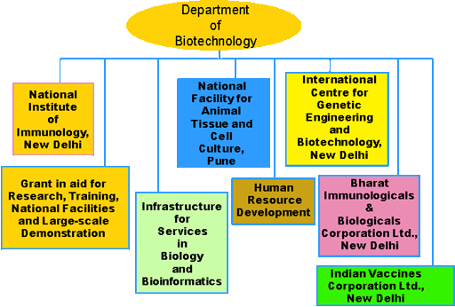
Dept of Biotechnology

Slide 14
Our Parnter pvt players
Abbott labs
Akumentis Healthcare
USV Healthcare
Centaur Pharmacueticals
Cipla
Dr. Reddys Laboratories
East India PharmaWorks Ltd
Emcure Pharma
Glenmark
Macleods
Sun pharma
Wockhardt
Ranbaxy

Slide 15
Agriculture
Technology Transfer for Pro-Poor Development
Creating, accelerating and nurturing global technology access for socio economic growth and entrepreneurial opportunities

Slide 16
Agriculture
Technology Transfer: A solution to prevailing agricultural and environmental problems
The AHRPL- DARE partnership: a potential model for implementing this solution
Scaling Up AHRPL- DARE the model Implementation

Slide 17
The Potential and Failure of Agricultural/Environmental Tech Transfer and Commercialization
Technologies created in developed countries can solve agricultural and environmental problems, meet local nutritional needs, and create business opportunities in developing regions
HOWEVER……….
the technologies are not delivered to the appropriate entrepreneurs, businesses and agencies who can adapt them to local economic, structures and markets
What are the reasons for this failure?
Notes:
17

Slide 18
Available technologies
drought tolerant crop technologies
Late Blight disease resistance and improved agronomic traits in potato
insect resistance in eggplant
novel fruit and vegetable cultivars
nutritional enhancement and shelf life extension of foods
biological controls for crop protection
cell lines for veterinary medicine
research tools and technical properties

Slide 19
Scaling Up Challenges
Economic development related factors
  Enhancing technology access for international licensing
  Enticing Corporate innovators to contribute to public good and encourage them to engage in partnership with low income economies
  Create polities in countries that inhibit technology transfer and commercialization for economic growth
Capacity building implications (TTO’s)
  Creating qualified human resource across the developing nations with active cooperation of bodies and Associations located in Part 1 countries
  Creating sustainable Technology Transfer Organizations that can network globally
  Enhance capacity beyond TTOs for enterprise development and accelerated commercialization
  Enhance competency framework through continuing access to knowledge

Slide 20
Our Alliance
DARE ( Dept of Agriculture research & Education)
IIT , NIT,
Godrej Agrovet. Ltd,
Bayer Agro
IFFCO
NABARD
RCF

Slide 21
Low cost housing
Technology Transfer for Pro-Poor Development
Creating, accelerating and nurturing global technology access for socio economic growth and entrepreneurial opportunities

Slide 22
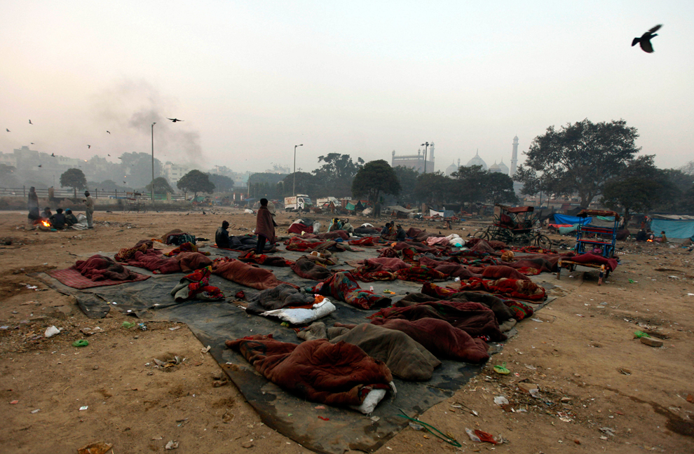
According to the United Nations Commission on Human Rights, there is an estimated 100 million homeless people worldwide. This is a startling statistic when you consider how affluent some parts of the world are..

Slide 23
Low cost housing
Affordable Housing in Partnership (AHIP) – The scheme
Affordable Housing in Partnership aims to promote various types of public-private partnerships
  private sector,
  cooperative sector,
  financial services sector,
  state parastatals
  urban local bodies,
  for realizing the goal of affordable housing for all.
This scheme is Jawaharlal Nehru National Urban Renewal Mission (JNNURM) and takes into account the experience of implementing Basic Services to the Urban Poor (BSUP) and Integrated Housing and Slum Development Programme (IHSDP).

Slide 24
Promotion of Technology for Low Cost Housing Materials – the collaborative Effort
Technology
Environment Friendly
Employment Generation
Energy Efficient
Simple Machine.
Small Enterprises.
Local People
involved.
Simple Machines
Less energy consuming
Products
Better Thermal comfort.
Utilization of agro industrial wastes.
Substitution of wood by
composite materials made of waste and local natural resources.
Top Soil Preservation.

Slide 25
Our Alliance
IIT , NIT,
Rural Housing technology,
National institute for Rural development

Slide 26
Achievements
Educational projects with SAARC
Socio economic uplifment of tribals with Manav seva lok kalyan mahasangh

Slide 27

Thank You
Ayur Hindustan Natural Resources Pvt ltd

